Slide 1

MID TERM DEFENSE
One Stop for trekking solution
BCA 4 th Semester
Laxmi Thami (6-2-263-16-2021)
Siddhartha Shakya(6-2-263-29-2021)
Kamal Tamrakar
HOD/CO-ORDINATOR

Slide 2

INTRODUCTION
OBJECTIVE
DFD 0,1
USE CASE DIAGRAM
ACTIVITY DIAGRAM
TABLE IN DATABASE SCHEMA
GANTT CHART
SCREEN LAYOUT

Slide 3
1.Introduction
Development of a unique e-commerce website targeting Nepal's trekking market.
Leveraging Nepal's trekking landscape and cultural heritage.
Offering a one-stop destination for adventurous travelers.
Providing curated selection of trekking gear, personalized recommendations, and local expertise.
Utilizing CRUD for achieving necessary functionality.

Slide 4
2.Objectives
Establish an online platform that specializes in offering Nepali-made trekking equipment.
Emphasize quality, affordability, and accessibility in the selection of products and Promote Nepali craftsmanship and support local artisans.

Slide 5
2.DFD LEVEL

Slide 6
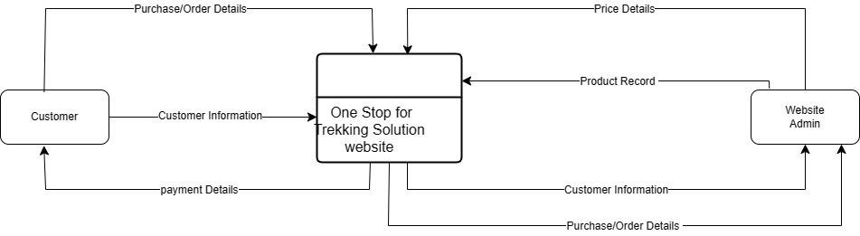
DFD LEVEL 0

Slide 7
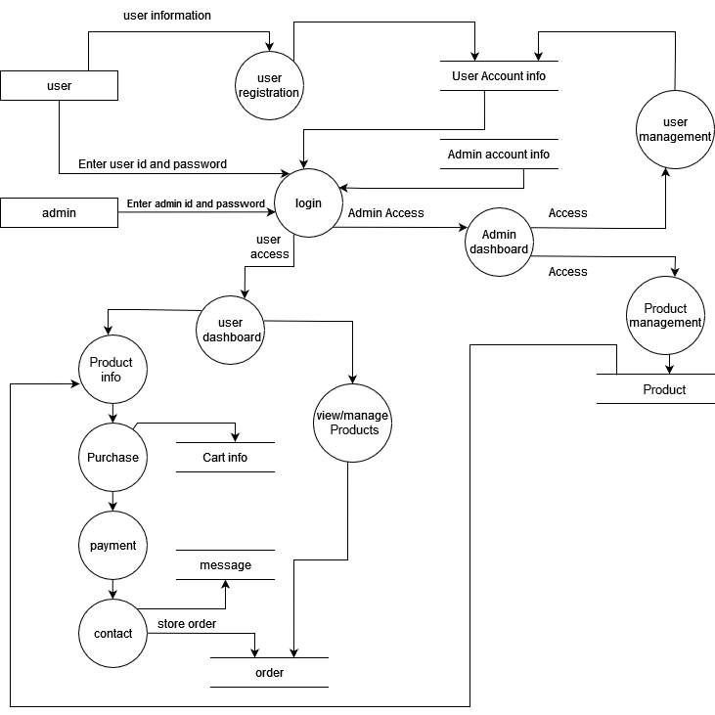
DFD LEVEL 1

Slide 8
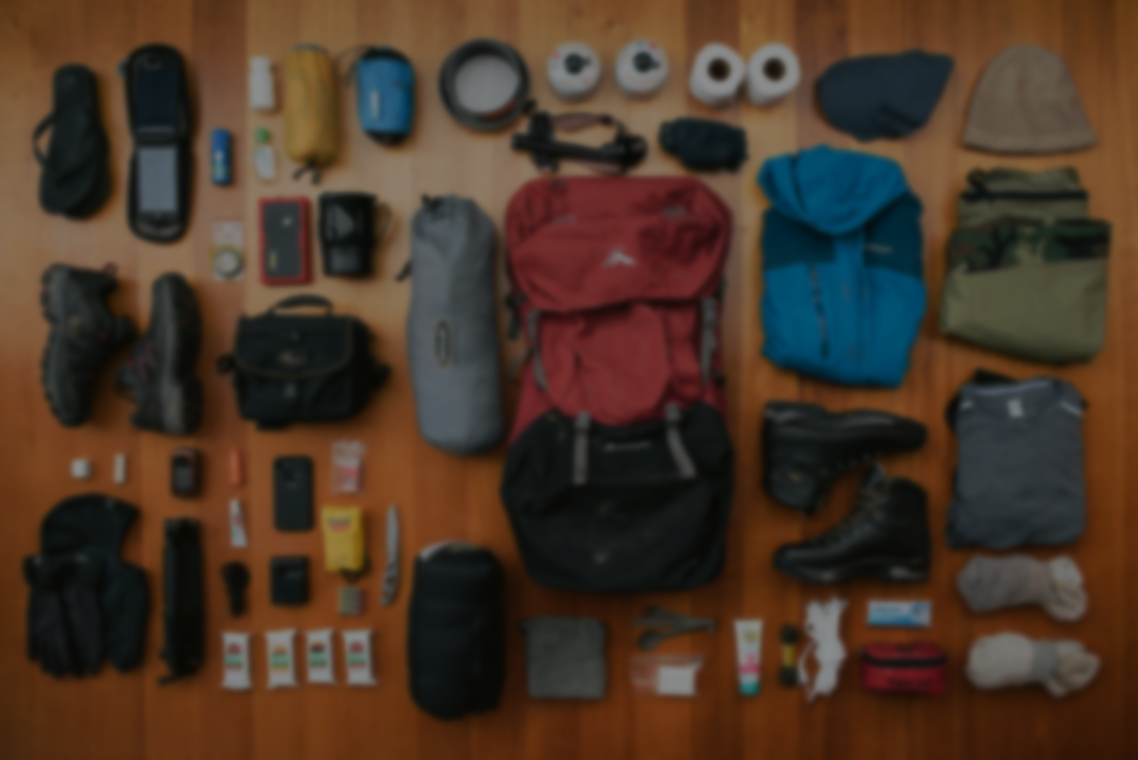
3.USE CASE DIAGRAM

Slide 9
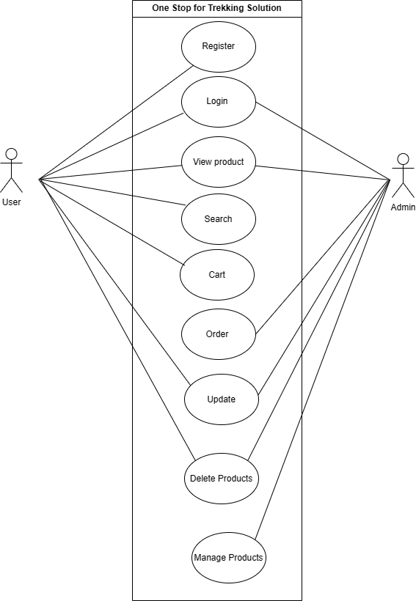
USE CASE DIAGRAM

Slide 10
4.ACTIVITY DIAGRAM

Slide 11
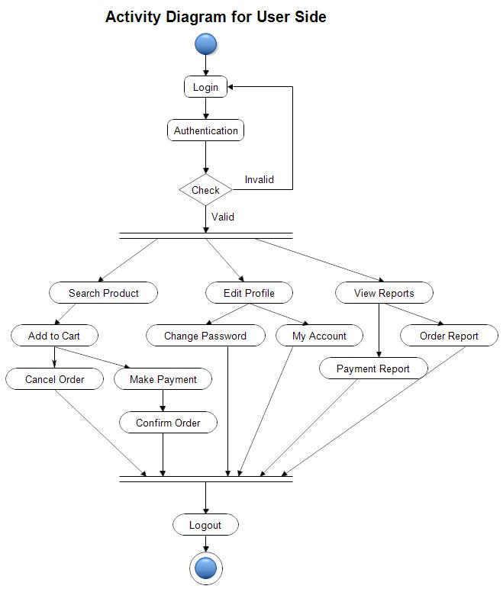

Slide 12
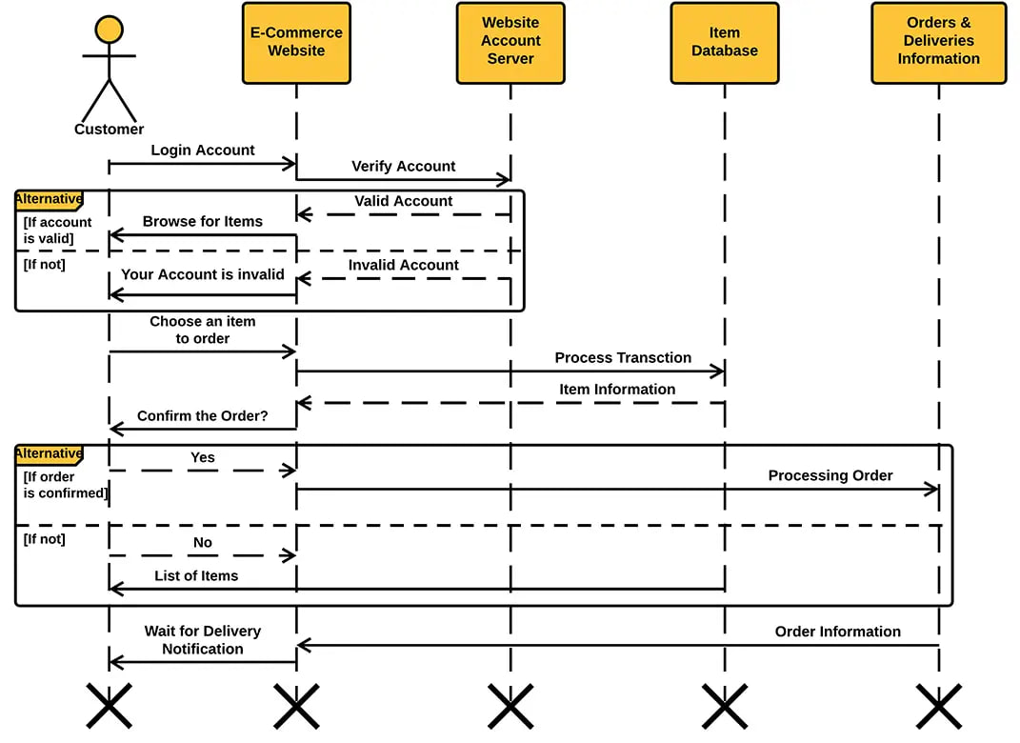

Slide 13
5.TABLE IN DATABASE SCHEMA

Slide 14
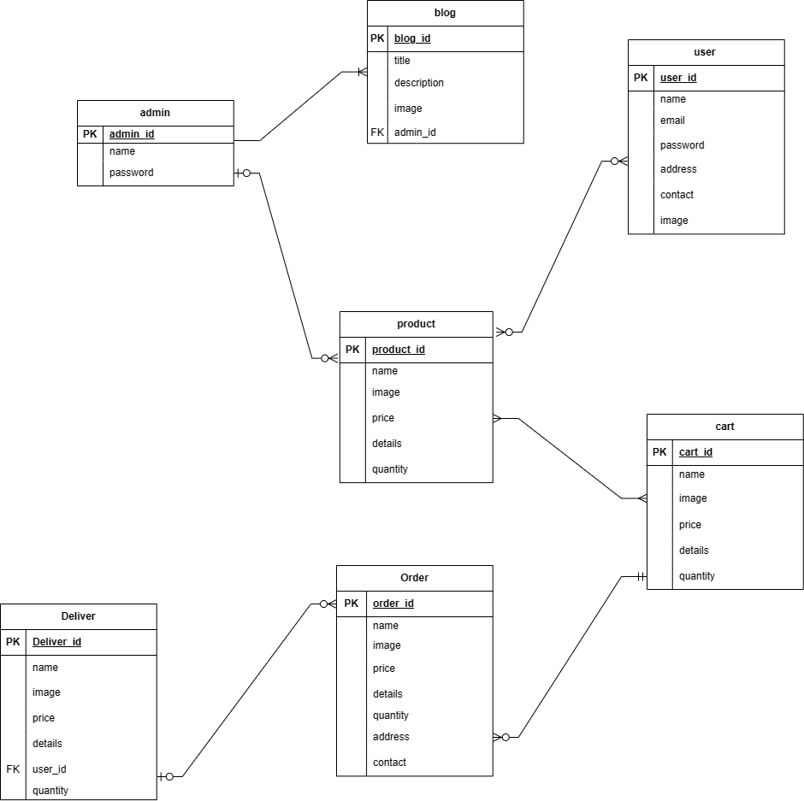
DATABASE SCHEMA

Slide 15
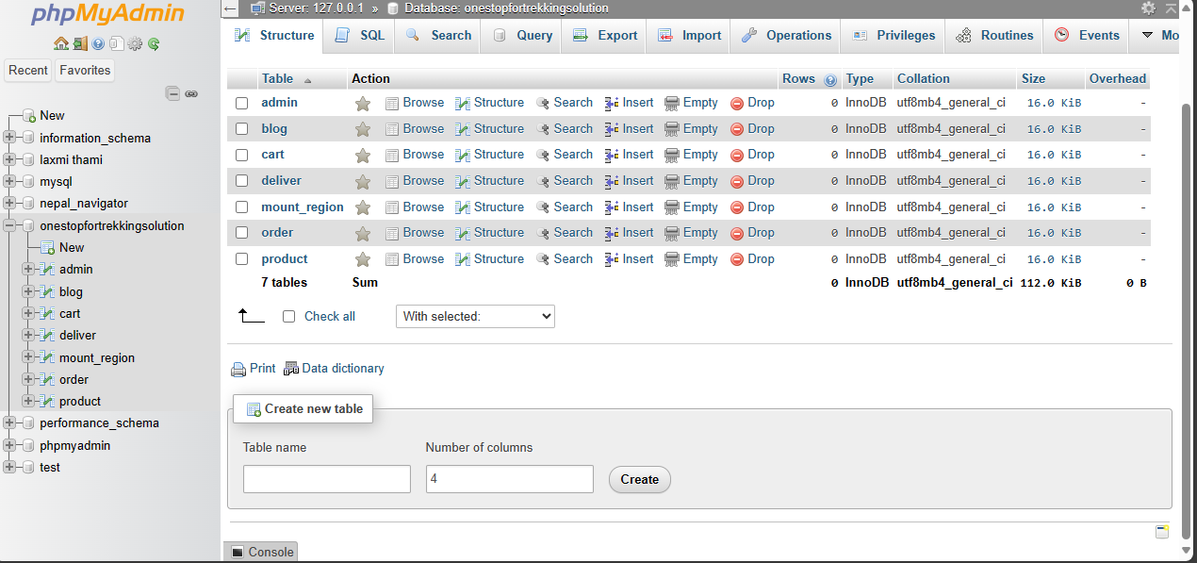

Slide 16
6. GANTT CHART

Slide 17
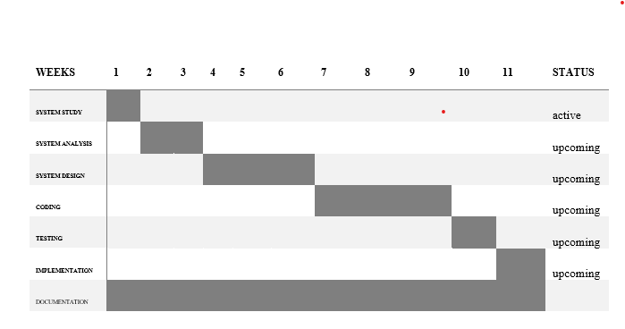
Gantt chart

Slide 18
7.SCREEN LAYOUT

Slide 19
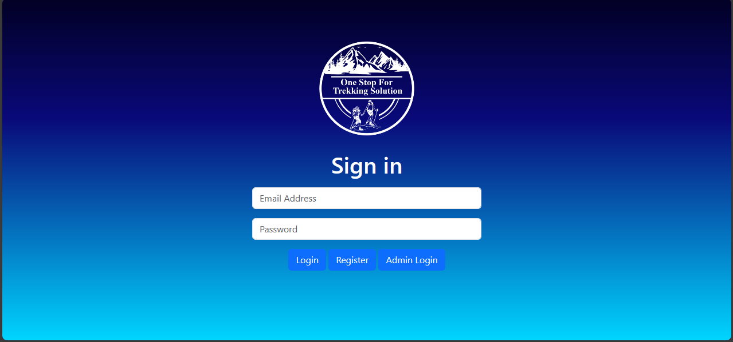
Login Page

Slide 20
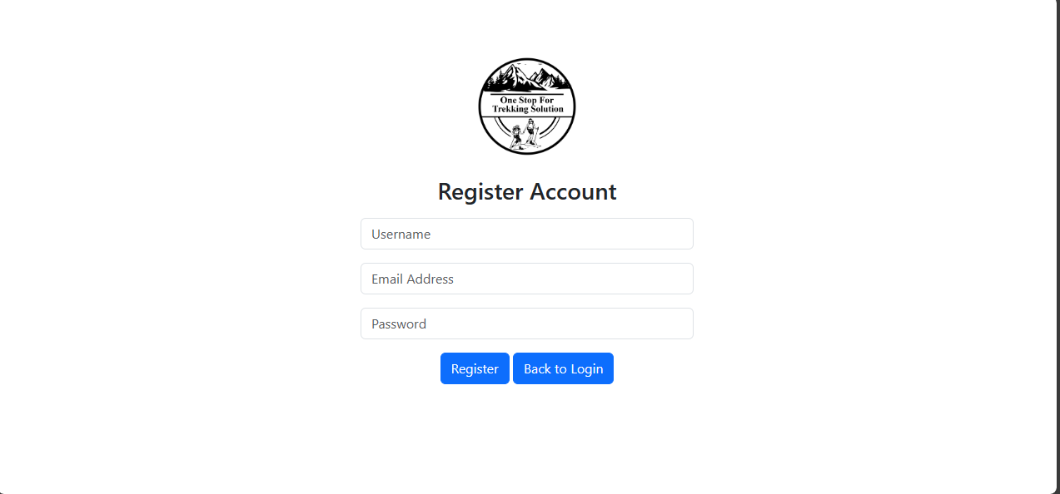
Register Page

Slide 21
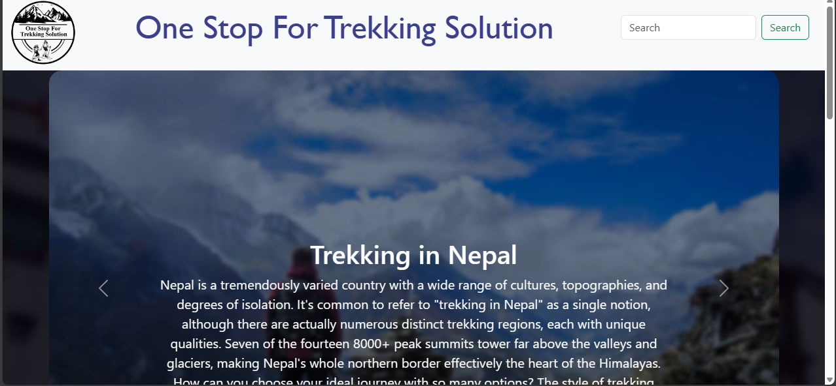
Home page (Blog post)

Slide 22
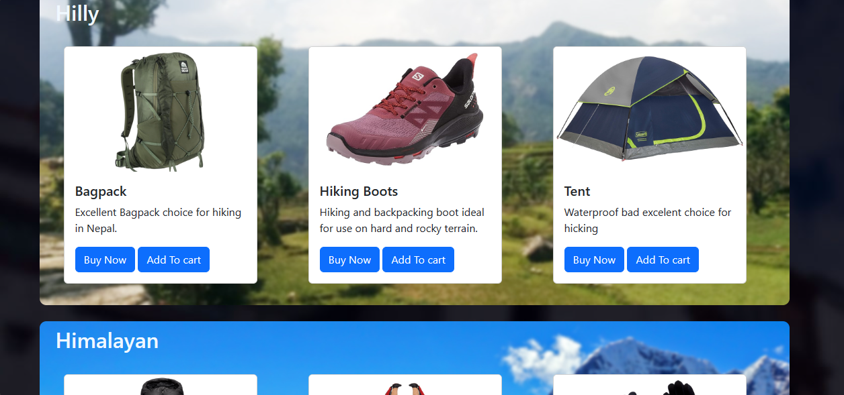
Home page (Product category)

Slide 23
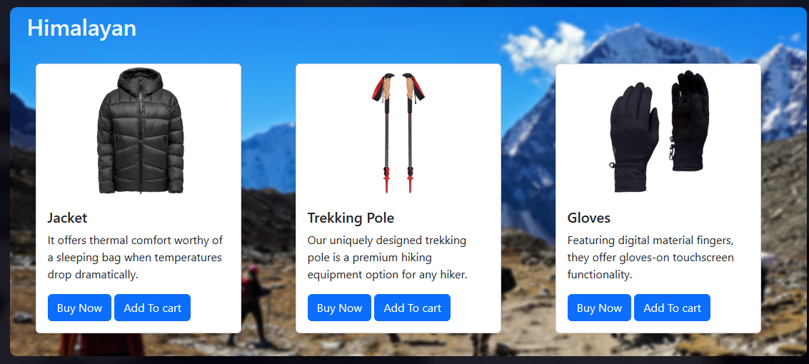
Home page (Product category)

Slide 24
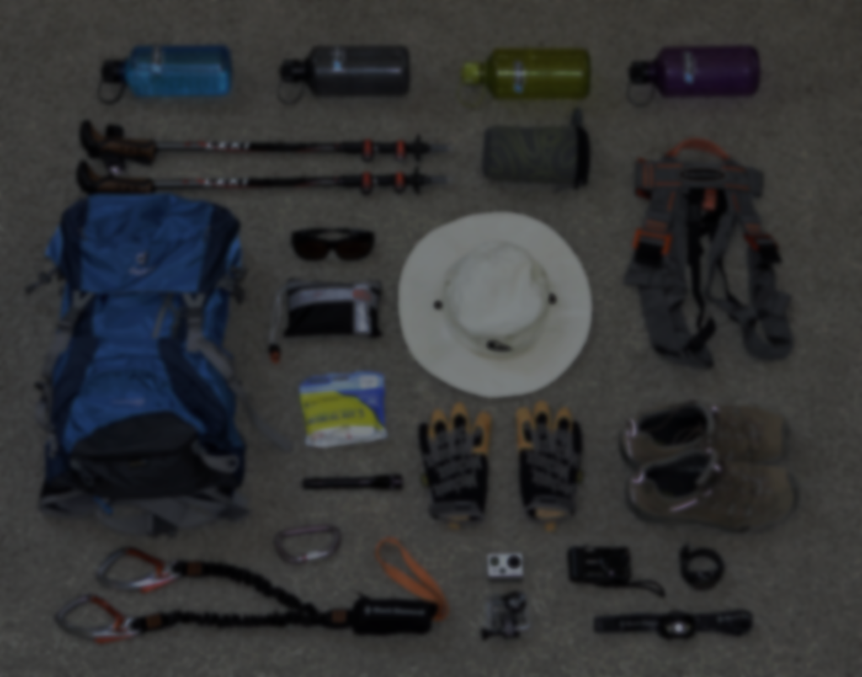
Expected Outcome
Cultural and Local Engagement
Community Involvement
Participation in Tourism Promotion

Slide 25
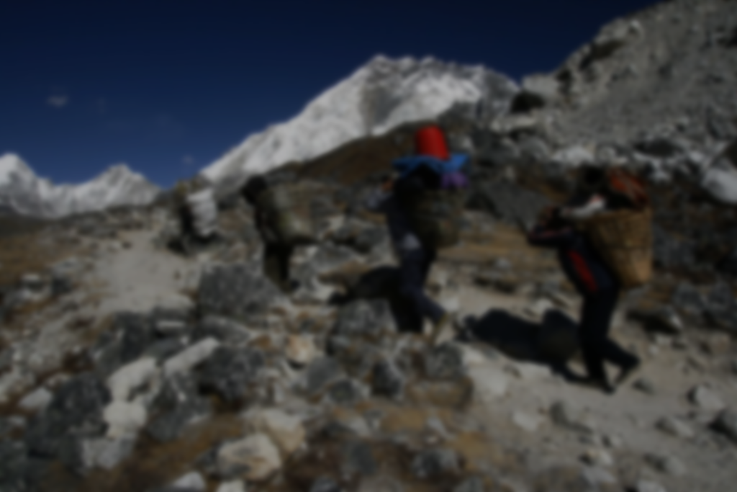
Limitation
Dependency on third-party suppliers and logistics may lead to delays.
Security vulnerabilities in online transactions.
Competition from established offline and online retailers.

Slide 26


Slide 27
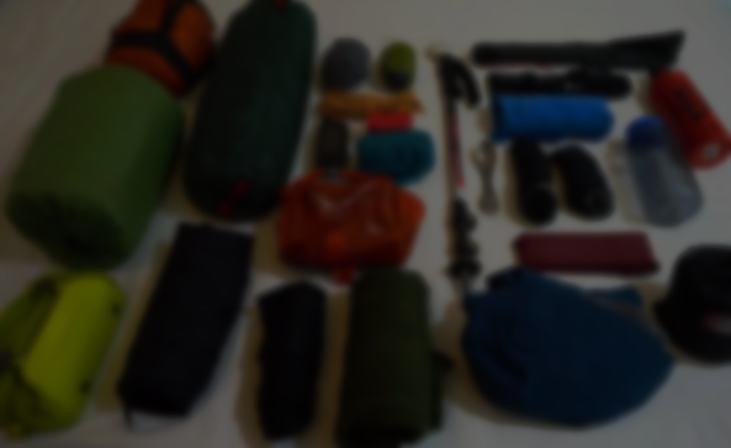
Thank You

